Slide 1
ISA: An Intelligent Shopping Assistant
~Tuan Manh Lai, Trung Bui , Nedim Lipka
Presented By
Farhan Shahoriar
Id:18101682
Group:08

Slide 2
Introduction
Improve shopping experience in physical store
ISA assists users by leveraging advanced techniques
in-store users only needs to take a picture or scan the barcode of the product
automated solutions can increase customer satisfaction and retention.

Slide 3
System Description
-user just needs to take a picture or scan the barcode of the product.The system then retrieves the information of the product of interest from a database by using computer vision techniques.
user can ask natural language questions about the product specifications to the system
a mobile client communicates with the backend through a well-defined HTTP REST API.

Slide 4
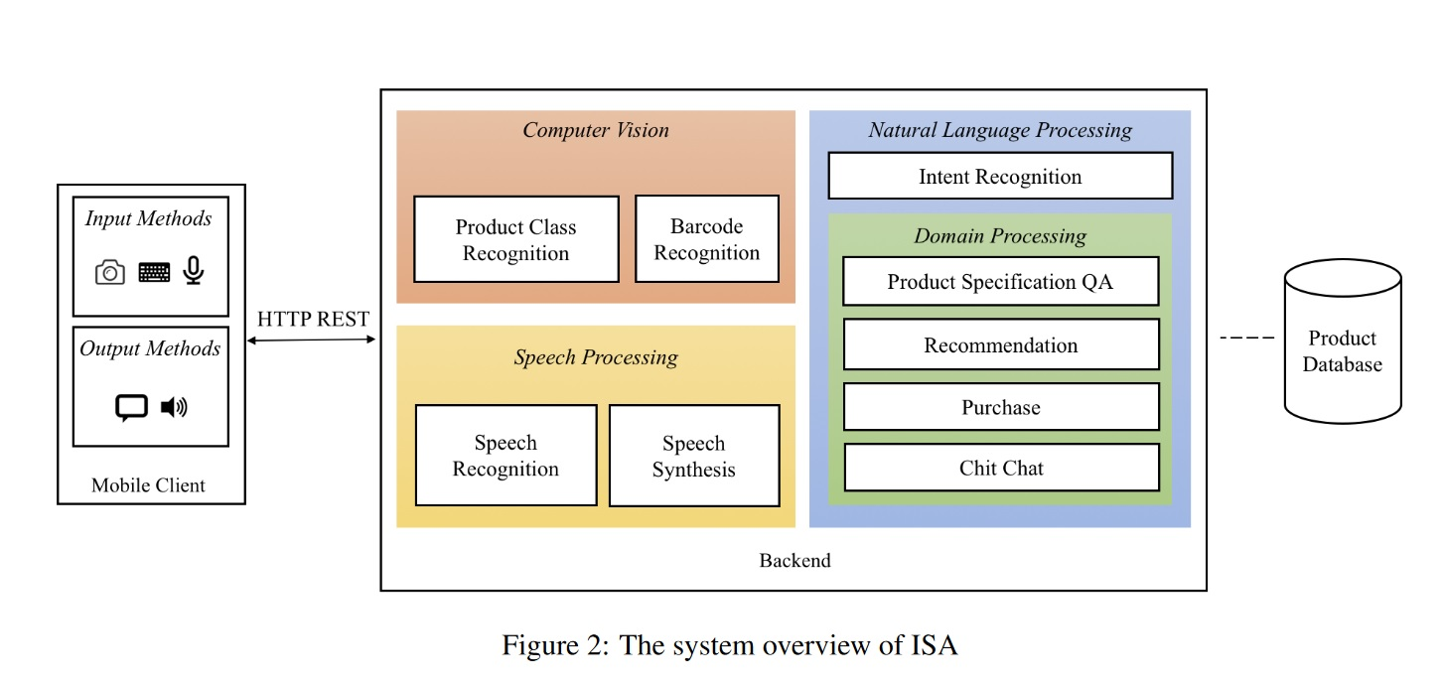

Slide 5
Overview
Computer vision
Product class Recognition
Barcode recognition
Speech processing
Speech recognition
Speech synthesis

Slide 6
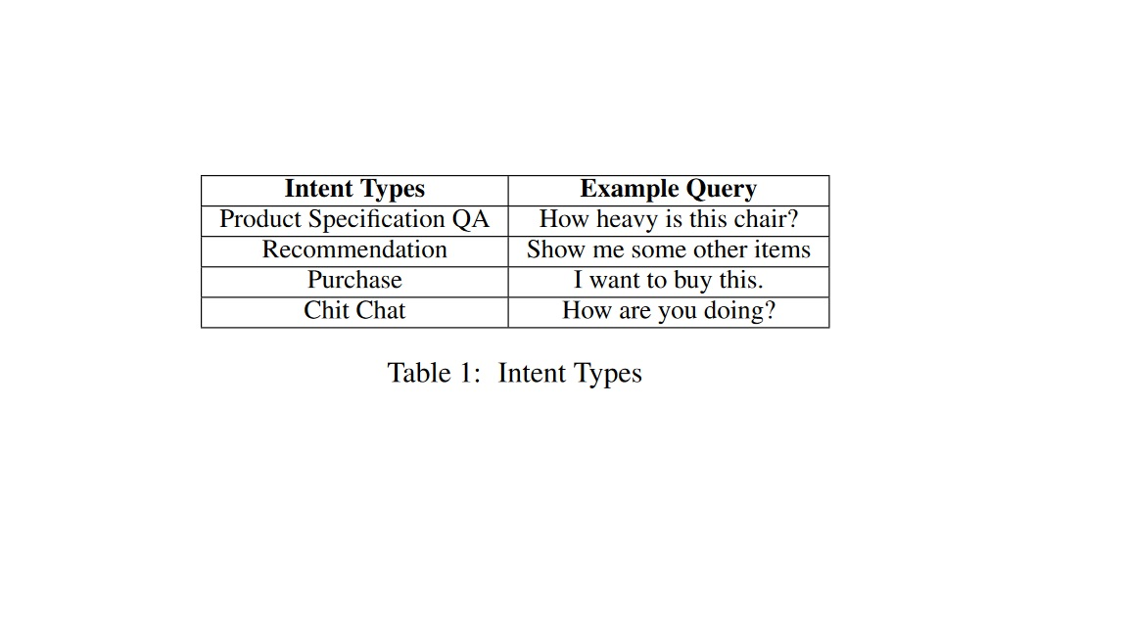
Natural language processing
Intent Recognition
ISA receives a query from a user, the intent recognition engine is used to determine the intent of the query

Slide 7
Intent classification
500 different queries to build a random forest for intent classification
⅔ of the cases are used as training set and the rest ⅓ used as test set
The number of trees in the forest is set to be 80
the number of features used to determine the best split is set to be √k

Slide 8
Product Specification QA
QA engine is used to answer questions regarding the specifications of a product. For every product, there is a list of specifications in the form of (specification name, specification value).
Recommendation
new suggestions and recommendations to users when a user wants to look for similar products
Purchase
guiding the user through the purchase process
ChitChat
The chit chat engine is used to reply to greeting queries

Slide 9
Data set
7119 question(from amt)
153 products
369 specification

Slide 10
Conclusion
ISA is designed to achieve the goal of improving shopping experience in physical stores by leveraging advanced techniques

